Slide 1
Operation Analytics and Investigating Metric Spike
Presented By : Rahul Vishwakarma

Slide 2
Description
Operational Analytics is a crucial process that involves analyzing a company's end-to-end operations. This analysis helps identify areas for improvement within the company. As a Data Analyst, My work closely with various teams, such as operations, support, and marketing, helping them derive valuable insights from the data they collect.
One of the key aspects of Operational Analytics is investigating metric spikes. This involves understanding and explaining sudden changes in key metrics, such as a dip in daily user engagement or a drop in sales.

Slide 3
Job Data Analysis

Slide 4
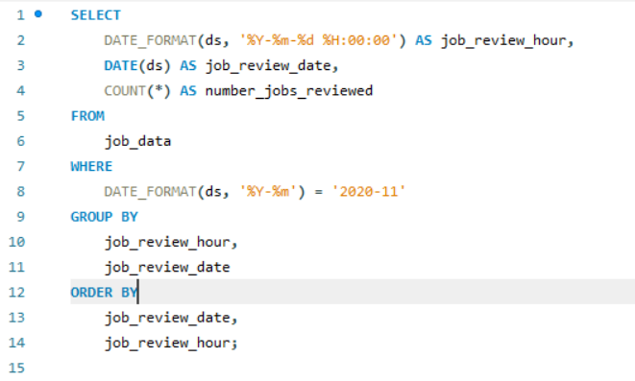

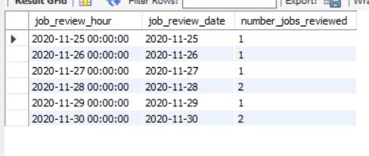
Calculate the number of jobs reviewed per hour for each day in November 2020.
Jobs Reviewed Over Time
SELECT
DATE_FORMAT(ds, '%Y-%m-%d %H:00:00') AS job_review_hour, DATE(ds) AS job_review_date,
COUNT(*) AS number_jobs_reviewed
FROM job_data
WHERE DATE_FORMAT(ds, '%Y-%m') = '2020-11’
GROUP BY job_review_hour, job_review_date
ORDER BY job_review_date, job_review_hour;
Jobs were reviewed steadily hour by hour each day in November 2020, showing a consistent workflow without major spikes. This suggests balanced staffing or well-paced review scheduling, allowing for efficient allocation of resources and minimizing bottlenecks in daily operations. Patterns can inform future process improvements.

Slide 5
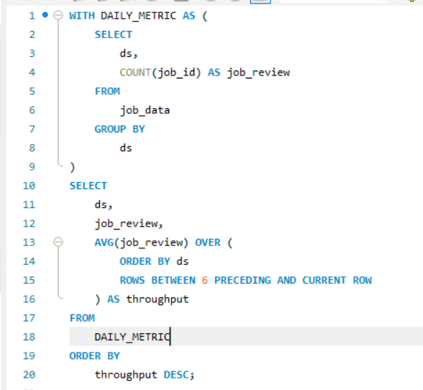
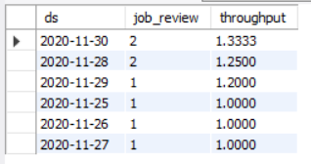
Calculate the 7-day rolling average of throughput (number of events per second).
Throughput Analysis
Write an SQL query to calculate the 7-day rolling average of throughput. Additionally, explain whether you prefer using the daily metric or the 7-day rolling average for throughput, and why.
WITH DAILY_METRIC AS
( SELECT ds, COUNT(job_id) AS job_review
FROM job_data
GROUP BY ds)
SELECT ds, job_review, AVG(job_review)
OVER ( ORDER BY ds ROWS BETWEEN 6 PRECEDING AND CURRENT ROW ) AS throughput
FROM DAILY_METRIC
ORDER BY throughput DESC;
I recommend using the 7-day rolling average for most analysis and long-term analysis, and the daily metric for monitoring and alerting.

Slide 6
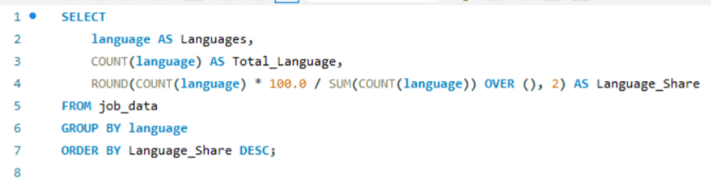

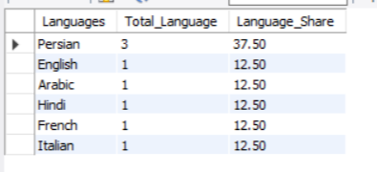
Calculate the percentage share of each language in the last 30 days. Write an SQL query to calculate the percentage share of each language over the last 30 days.
Language Share Analysis:
SELECT language AS Languages,
COUNT(language) AS Total_Language,
ROUND(COUNT(language) * 100.0 / SUM(COUNT(language)) OVER (), 2) AS Language_Share
FROM
job_data
GROUP BY language
ORDER BY Language_Share DESC;
The query shows which languages are most common in job data. Persian is the most popular, with 37.5% share, while other languages like English, Arabic, and Hindi each have 12.5%. This helps us see which languages are most needed, helping companies focus on those for job postings.

Slide 7
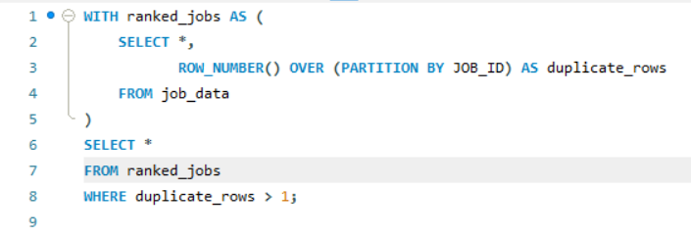
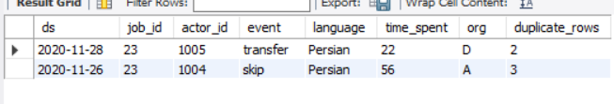
Identify duplicate rows in the data. Write an SQL query to display duplicate rows from the job_data table.
Duplicate Rows Detection
WITH ranked_jobs AS
( SELECT *, ROW_NUMBER() OVER (PARTITION BY JOB_ID) AS duplicate_rows
FROM job_data)
SELECT *
FROM ranked_jobs
WHERE duplicate_rows > 1;
The query helps find duplicate job entries in the data. By using the row number function and filtering for duplicates, we can easily see which jobs appear more than once. This helps companies clean their database, avoid mistakes, and keep their job records accurate and organized.

Slide 8
Investigating Metric Spike

Slide 9
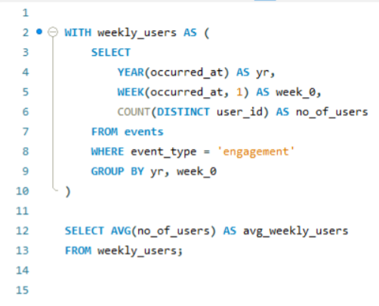


Measure the activeness of users on a weekly basis
Weekly User Engagement
Write an SQL query to calculate the weekly user engagement.
WITH weekly_users AS
( SELECT YEAR(occurred_at) AS yr,
WEEK(occurred_at, 1) AS week_0,
COUNT(DISTINCT user_id) AS no_of_users
FROM events
WHERE event_type = 'engagement'
GROUP BY yr, week_0)
SELECT AVG(no_of_users) AS avg_weekly_users
FROM weekly_users;
The query finds the average number of users who engaged every week, which is about 3,732. This number helps the company understand its weekly activity. If the number goes up, more people are using the platform. If it drops, they may need to find ways to boost user engagement.

Slide 10
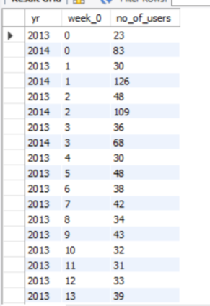
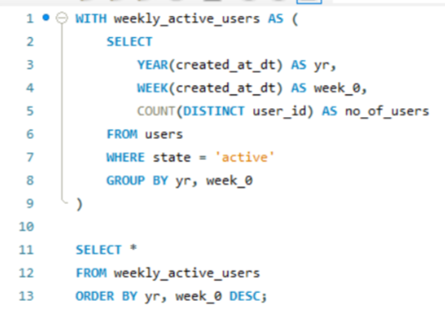

Analyze the growth of users over time for a product
User Growth Analysis
Write an SQL query to calculate the user growth for the product.
WITH weekly_active_users AS
( SELECT YEAR(created_at_dt) AS yr,
WEEK(created_at_dt) AS week_0,
COUNT(DISTINCT user_id) AS no_of_users
FROM users
WHERE state = 'active'
GROUP BY yr, week_0)
SELECT *FROM weekly_active_users
ORDER BY yr, week_0 DESC;
Every week, we count how many users are active on the platform. By checking user activity, the company can see if more people are joining or leaving. This helps them understand user trends and know when to improve features or bring new users to keep the platform growing.

Slide 11
Analyze the retention of users on a weekly basis after signing up for a product.
Weekly Retention Analysis
Write an SQL query to calculate the weekly retention of users based on their sign-up cohort.
WITH weekly_active_users AS
( SELECT YEAR(created_at_dt) AS yr,
WEEK(created_at_dt) AS week_0,
COUNT(DISTINCT user_id) AS no_of_users
FROM users
WHERE state = 'active'
GROUP BY yr, week_0)
SELECT *FROM weekly_active_users
ORDER BY yr, week_0 DESC;
The data shows the number of unique active users each week. We can see big changes week to week, with some weeks having over 100 users while others are much lower. This means user activity is not steady and may depend on events or specific factors during those weeks.

Slide 12
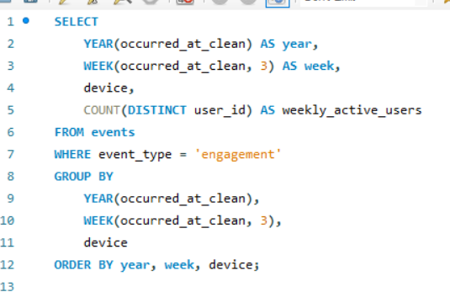
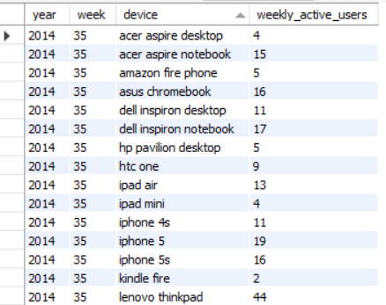
Measure the activeness of users on a weekly basis per device.
Weekly Engagement Per Device
Write an SQL query to calculate the weekly engagement per device.
SELECT
YEAR(occurred_at_clean) AS year,
WEEK(occurred_at_clean, 3) AS week,
device,
COUNT(DISTINCT user_id) AS weekly_active_users
FROM events
WHERE event_type = 'engagement’
GROUP BY YEAR(occurred_at_clean), WEEK(occurred_at_clean, 3), device
ORDER BY year, week, device;
The query counts how many different users are active each week on different devices. This helps the company see which devices are most popular and when people use them most. Tracking weekly active users by device helps plan updates, fix issues, and make sure the platform works well for everyone.

Slide 13
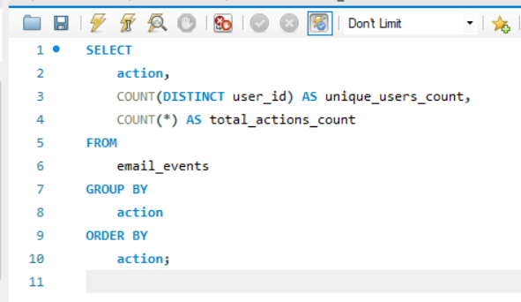
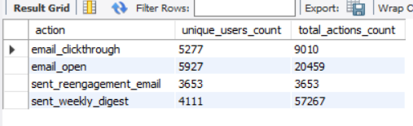
Analyze how users are engaging with the email service.
Email Engagement Analysis
Write an SQL query to calculate the email engagement metrics.
SELECT
action,
COUNT(DISTINCT user_id) AS unique_users_count,
COUNT(*) AS total_actions_count
FROM email_events
GROUP BY action
ORDER BY action;
The data shows user actions on emails. Most users opened emails (5927 users, 26459 actions), meaning some opened multiple times. Weekly digests had 4111 users but a high total count (57627), showing repeated engagement. Clickthroughs were fewer (5727 users, 9019 actions), suggesting many open emails but fewer click on links.

Slide 14
Thank You

